Slide 1
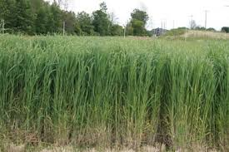
An Integrated Multimodal Transportation Model for a Switch Grass–Based Bioethanol Supply Chain
Case Study in North Dakota
Yong Shin Park, Joseph Szmerekovsky, Atif Osmani and N. Muhammad Aslaam
Upper Great Plains Transportation Institute, North Dakota State University
Switchgrass is one type of lignocellulosic feedstock that is suitable for cultivation on marginal land (with arid soil) without competing for cropland with other agriculture products
It is considered as one of the best second generation bioethanol feedstock due to the following economic, environmental and social benefit
Biofuels produced using switchgrass could reduce GHG emissions by 60% ~ 90% when compared with fossil fuels

Slide 2
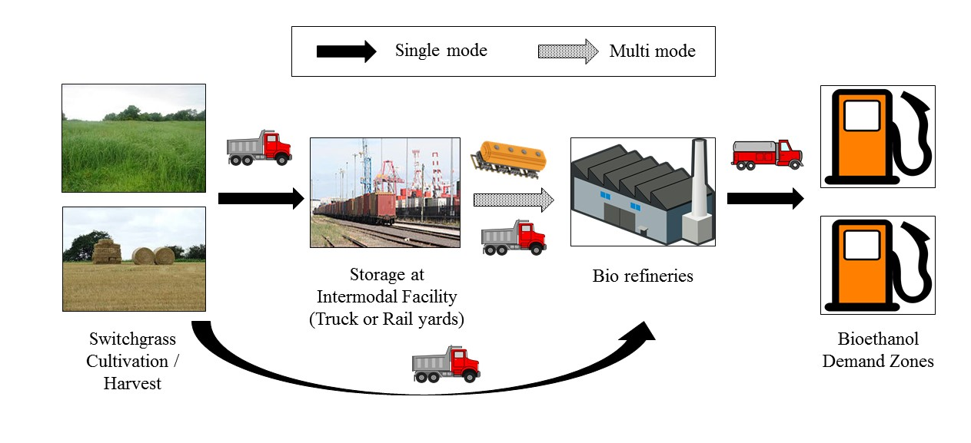
Method: Mixed Integer Linear Programming Optimization
Objective: Minimization of Total Supply Chain Cost
Strategic Decision: location of intermodal storage, number of intermodal storage, biorefinery location
Tactical Decision: amount of biomass harvested and shipped through the multimodal supply chain network, and amount of bioethanol produced
Session: 564, Current Issues in Alternative Transportation Fuels and Technologies
Session Location: Hall E / Convention Center
Session Time: Tuesday, Jan 10, 2017 10:15AM 12:00PM

